Slide 1
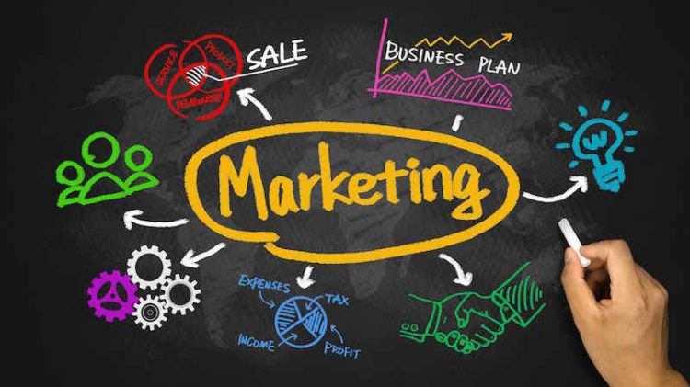
Text Book: Marketing Management
Kotler, Keller, Koshy, Jha (13th Ed.), Pearson Education
Chapter 1,8,10
Marketing Management
Chapter-5

Slide 2
Outline
After finishing the lecture you will be able to:
Define what market and marketing is
Describe what is marketed
Explain the 4P’s of marketing
Differentiate between mass marketing and micromarketing
Explain different types of micromarketing
Explain how market segments are selected
Understand the concepts of Brand and Brand Equity
Explain how brand elements are chosen
Develop a clear concept about Guerilla and Ambush Marketing

Slide 3
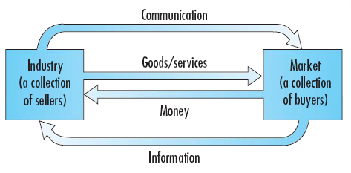
What is a Market?
A market is a physical place where buyers and sellers gathered to exchange goods and services.
Economists describe a market as collection of buyers and sellers.
Marketers view the sellers as constituting the industry and buyers as constituting the market.

Slide 4

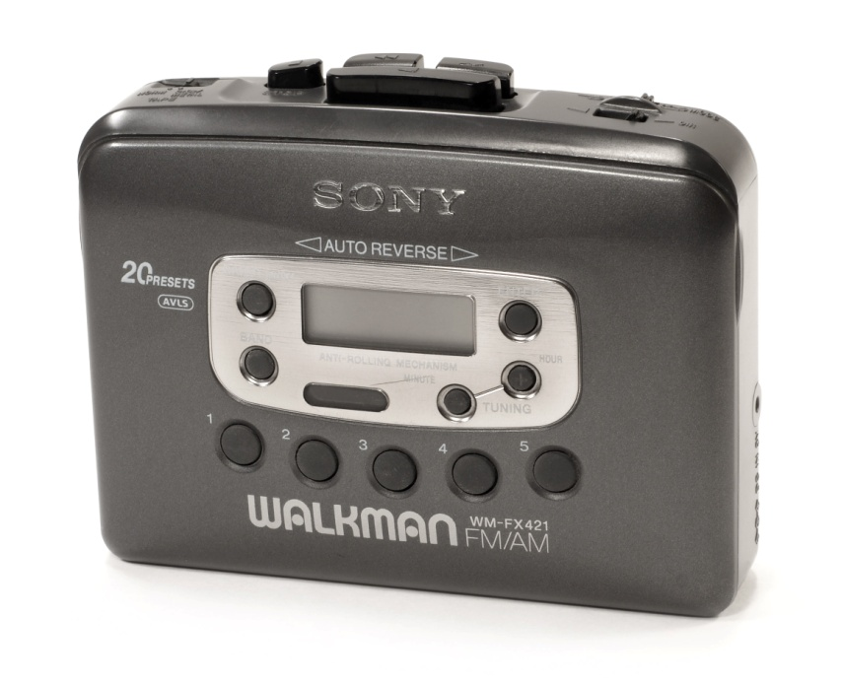

Marketing and Marketing Management
Marketing is an organizational function and a set of processes for creating, communicating and delivering value to the customers and for managing customer relationships in ways that benefit the organization and its stakeholders.

Slide 5

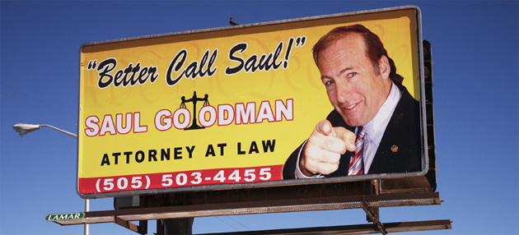

What is Marketed?
Goods (tangible)
Services (intangible)
Persons

Slide 6
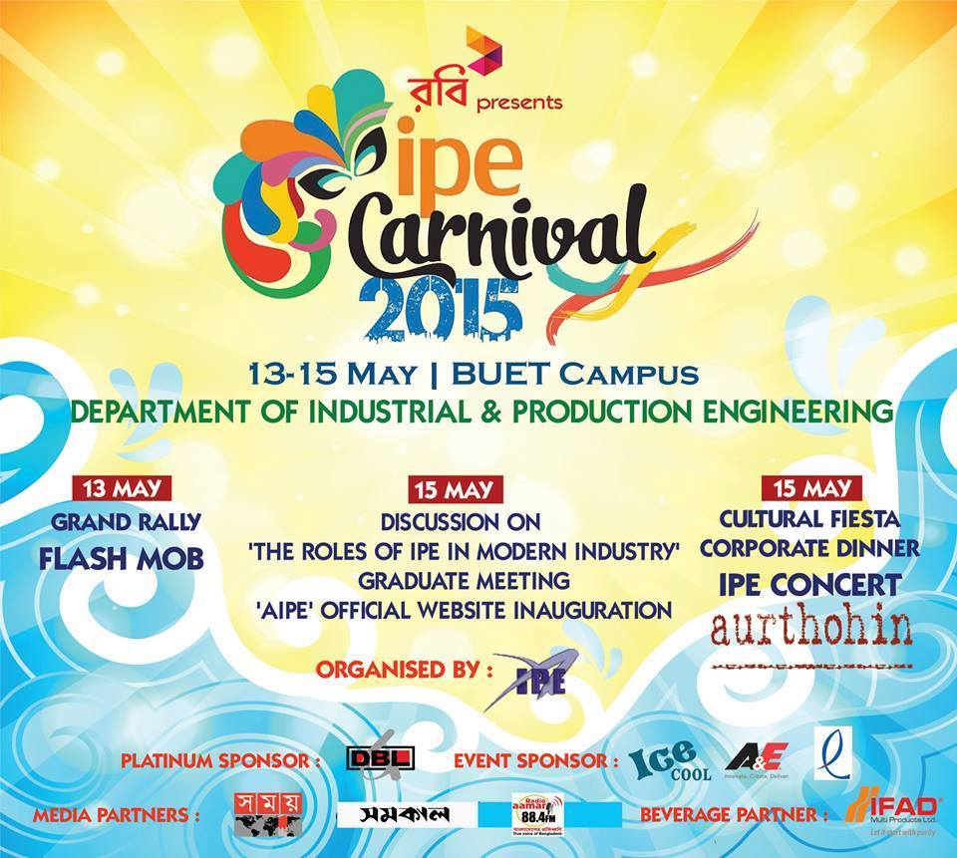

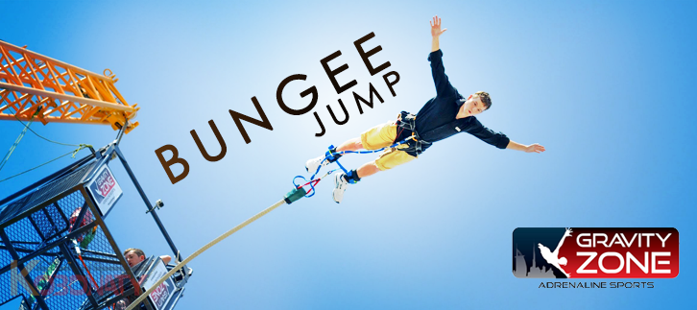
What is Marketed?
Events
Experiences

Slide 7



What is Marketed?
Places
Organizations
Ideas

Slide 8
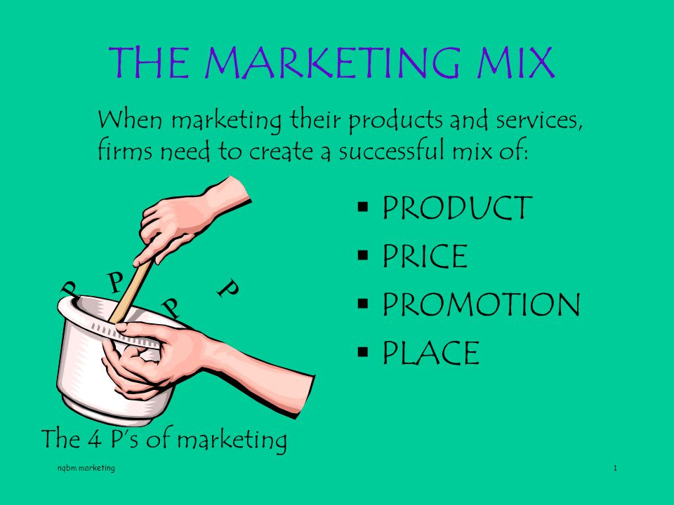
Marketing Mix
4 Ps of Marketing: You just need to create a product that a particular group of people want, put it on sale some place that those same people visit regularly, and price it at a level which matches the value they feel they get out of it; and do all that in a way so they want to buy.

Slide 9
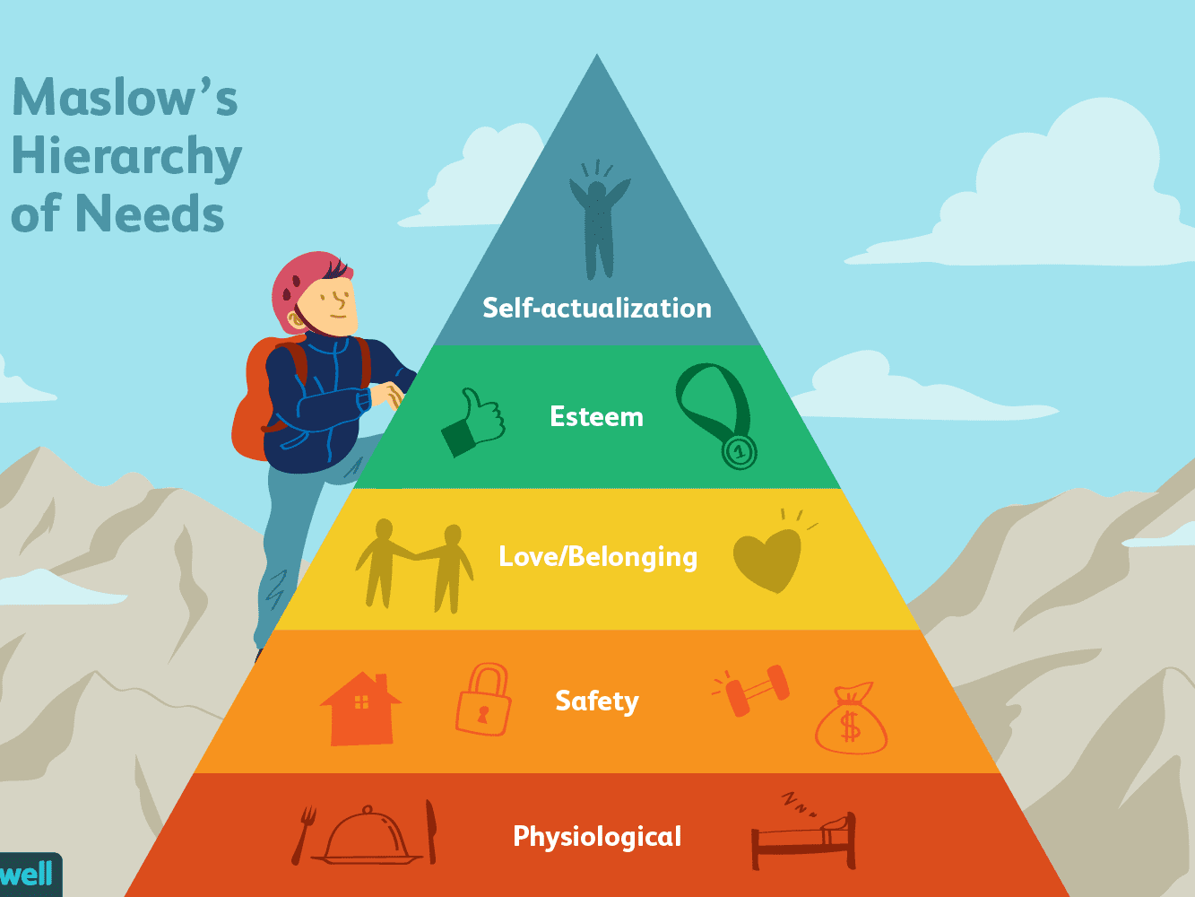
Different needs at different times

Slide 10
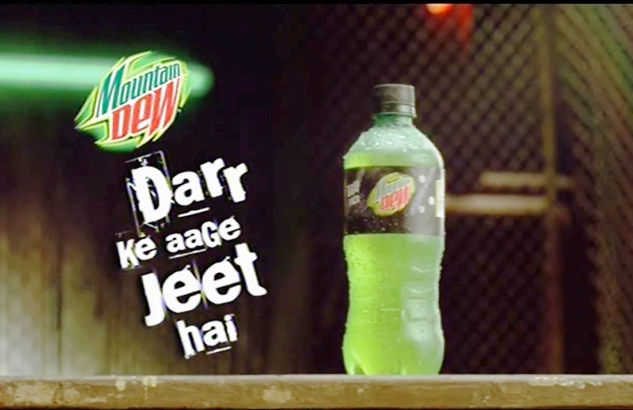
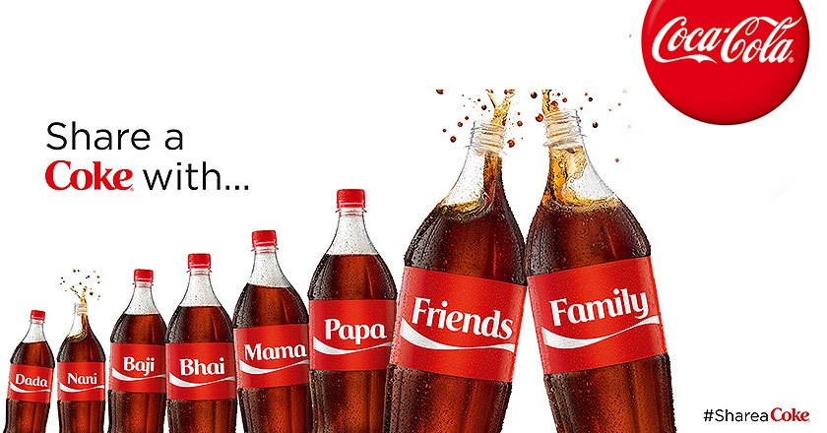
Mass Marketing and Micromarketing
In Mass marketing the seller engages in the mass production, mass distribution and mass promotion of one product for all buyers.
Most companies are turning into Micromarketing that relies on segmentation. Micromarketing has 4 levels.
Segment Marketing
Niche Marketing
Local Marketing
Individual Marketing

Slide 11
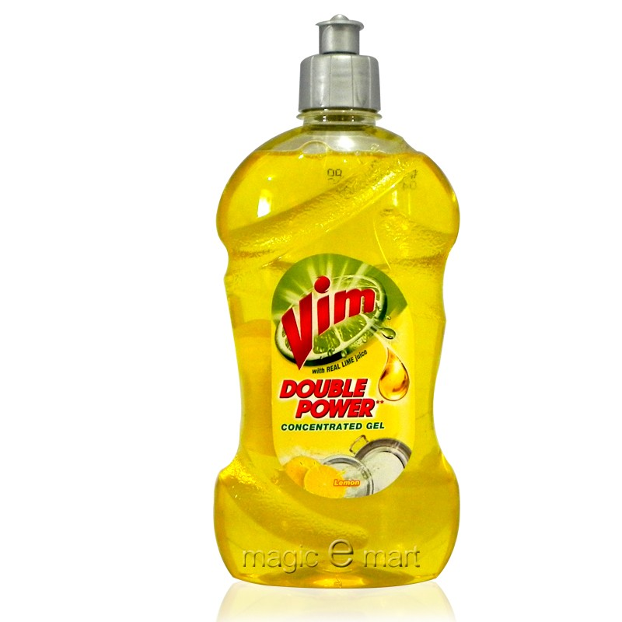
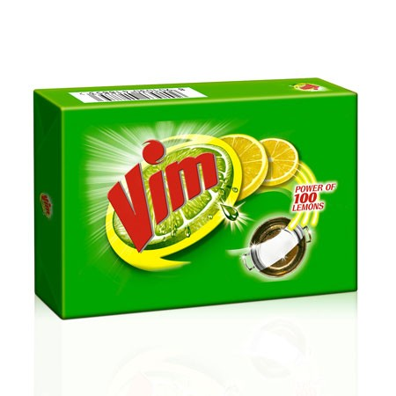
Segment Marketing
A market segment consists of group of customers who share a similar set of needs and wants.
Vim bar is for economy class and vim liquid cleaner is for premium segment.

Slide 12
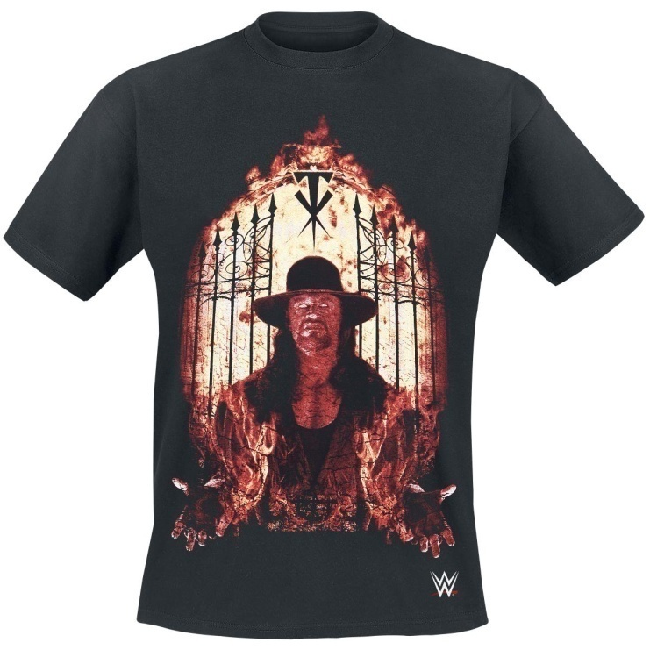

Niche Marketing
Niche is a special type of segment who need products that possess some unique characteristics. They are ready to pay premium prices for the products they need.
Niche segment is very small in size and a sensitive segment, as they are paying premium price they will definitely be more demanding.

Slide 13
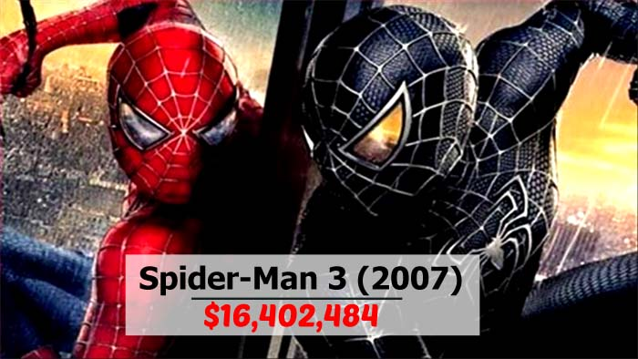
Local Marketing
Local marketing is based on the needs and wants of local consumer groups in trading areas or neighborhood.
Spiderman 3 was released in India in 5 languages in different regions, which even included Bhojpuri- a regional dialect! This strategy earned the movie highest collection record in India for a foreign movie.

Slide 14
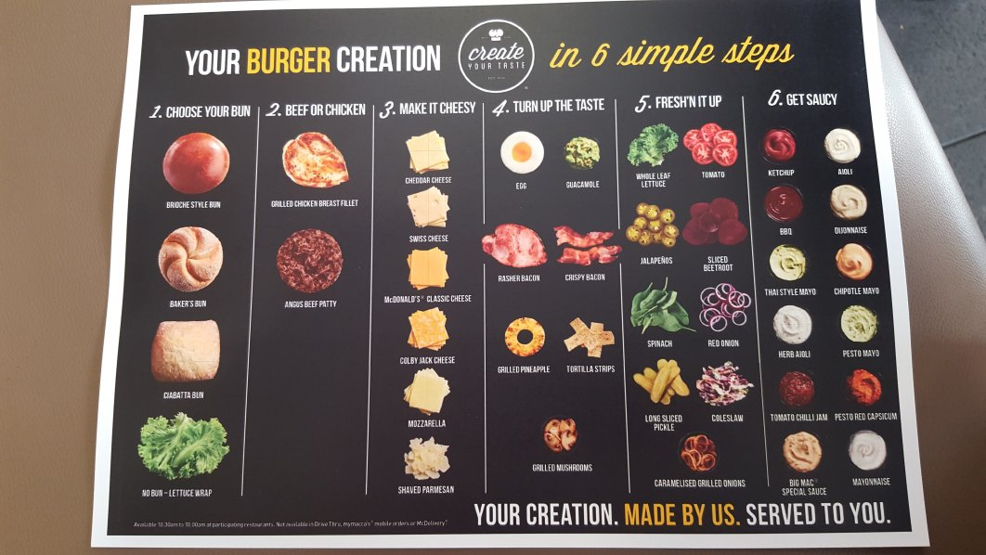

Individual Marketing
The ultimate level of segmentation leads to ‘one-to-one’ marketing or customized marketing for each individual.

Slide 15

Brand and Brand Equity
Brand is a name, term, sign, symbol, design or a combination of them, intended to identify the goods and services of one seller and to differentiate them from those of competitors.
Brand equity is the added value endowed on product and services. It may be reflected in the way customers think, feel and act with respect to the brand, prices & market share.

Slide 16
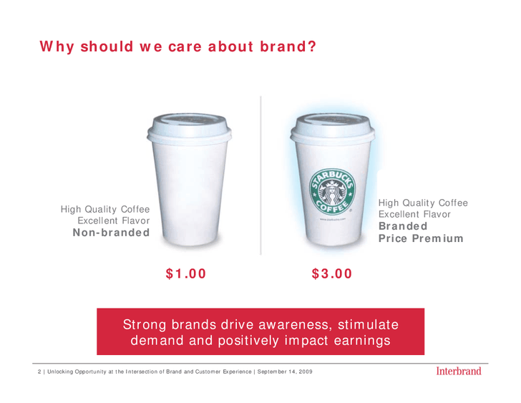

Slide 17


Choosing Brand Elements
Brand elements are those devices that identify and differentiate the brand. Such as: LOGO and Slogan (tagline). Most strong brands have multiple brand elements. Such as : NIKE

Slide 18

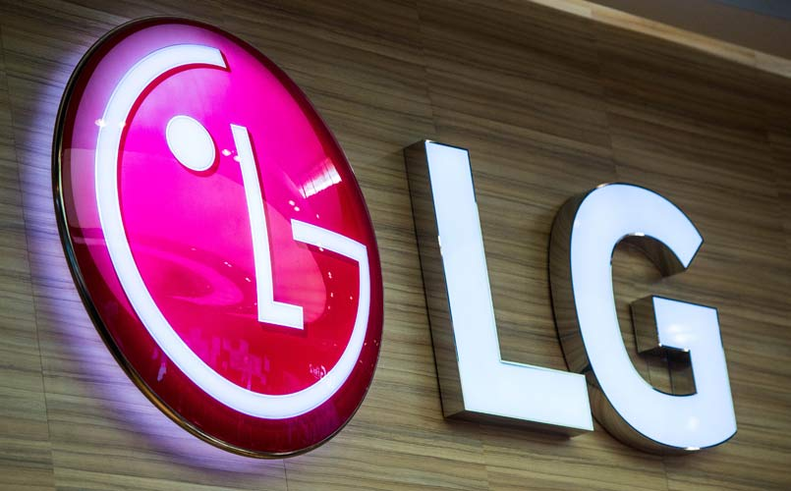
Choosing Brand Elements
Memorable: How easily can be the element remembered?

Slide 19
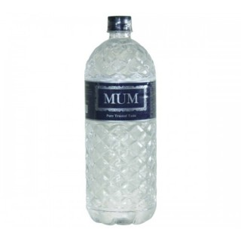

Choosing Brand Elements
Meaningful: Do they really have a meaning which goes along with the product/ service/ branding strategy?

Slide 20
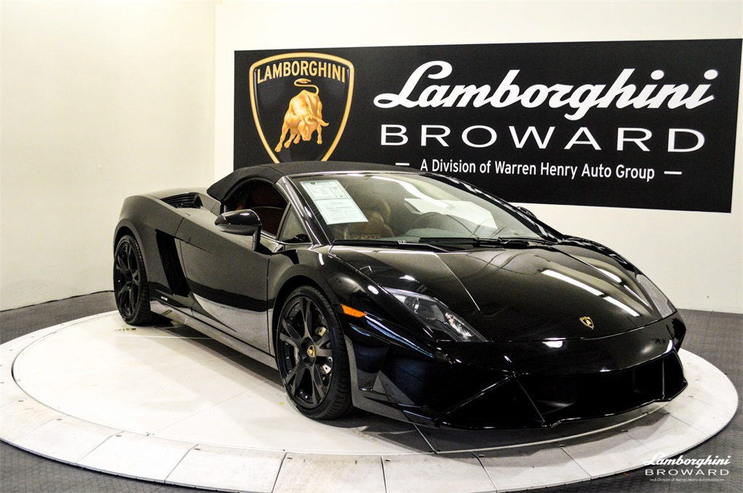

Choosing Brand Elements
Likable: How aesthetically appealing is the brand element?

Slide 21

Choosing Brand Elements
Transferable: Can the brand element be used to introduce new products or services of the same or different category?

Slide 22

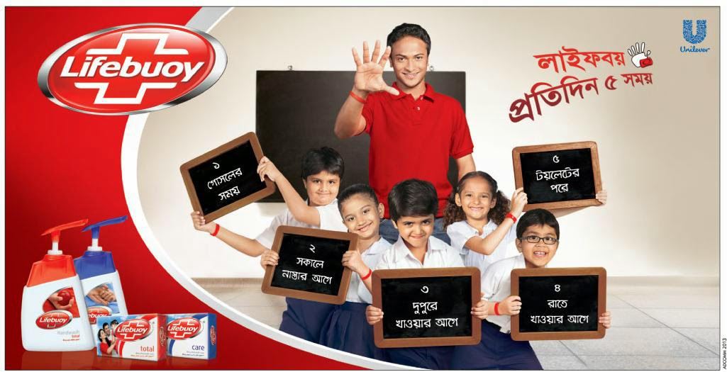
Choosing Brand Elements
Adaptable: How adaptable and updatable is the brand element?

Slide 23
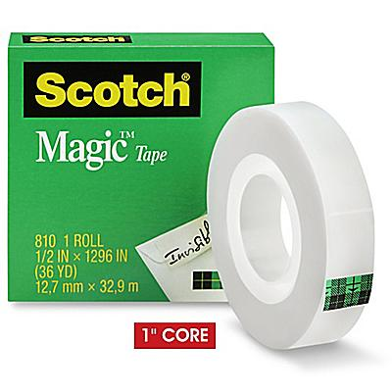
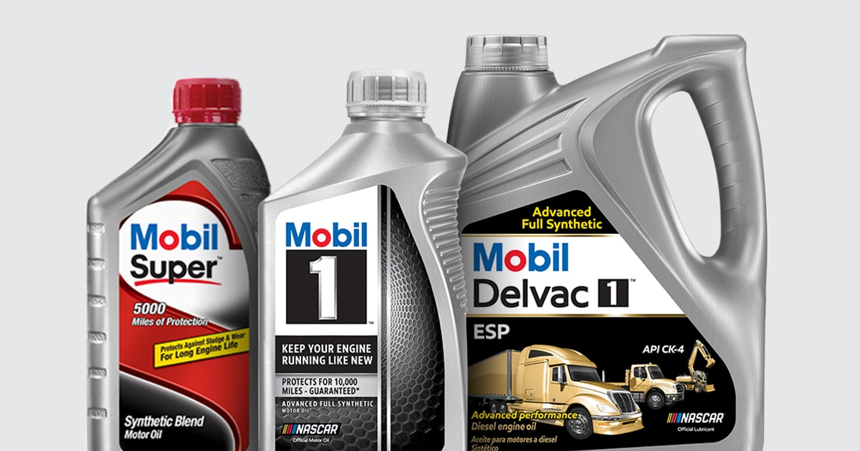
Choosing Brand Elements
Protectable: How legally protectable is the brand element? Are their Trademark protected?

Slide 24
Branding decisions: Which brand name to use:
Individual names
Blanket family names
Separate family names
Corporate name combined with individual product name

Slide 25
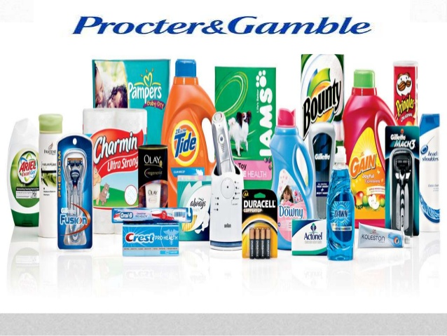
Individual names:

Slide 26

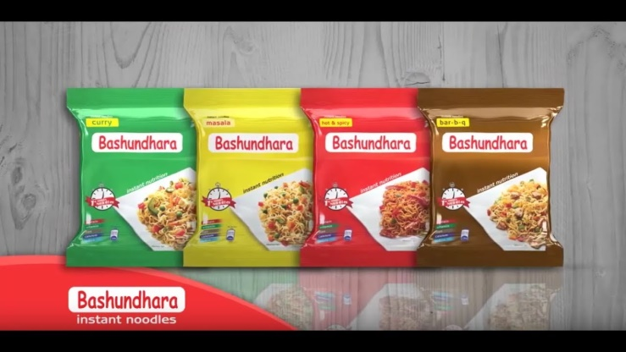
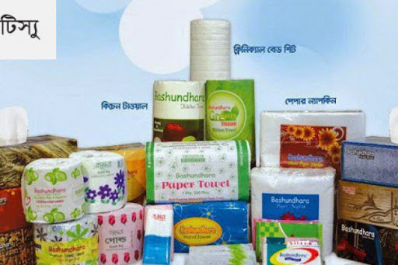
Blanket family Names:

Slide 27
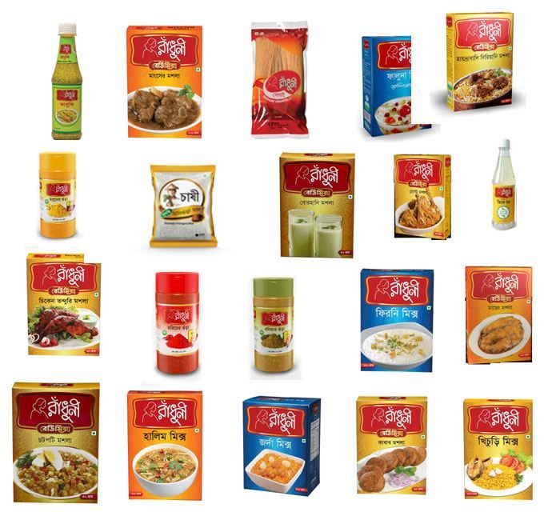
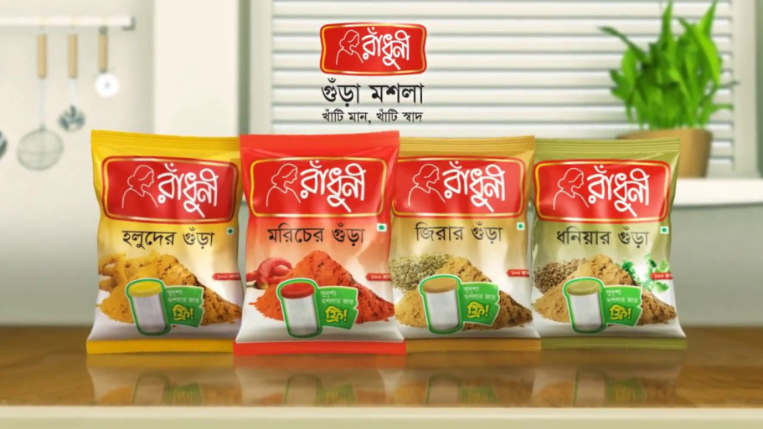
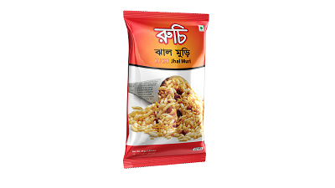
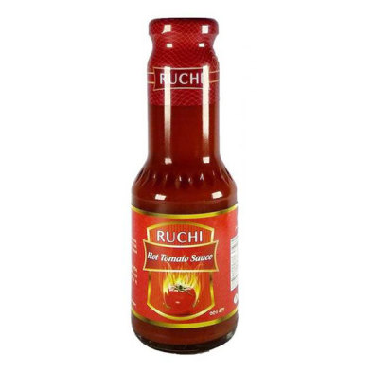
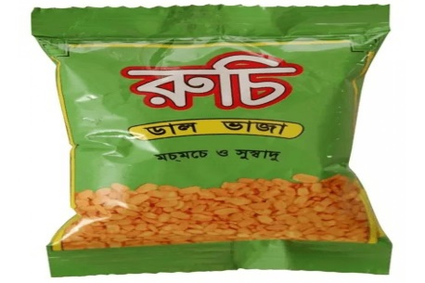
Separate family names:

Slide 28
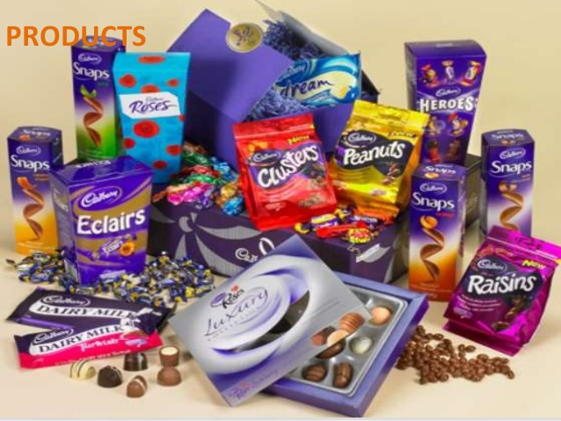
Corporate name combined with individual product name:

Slide 29
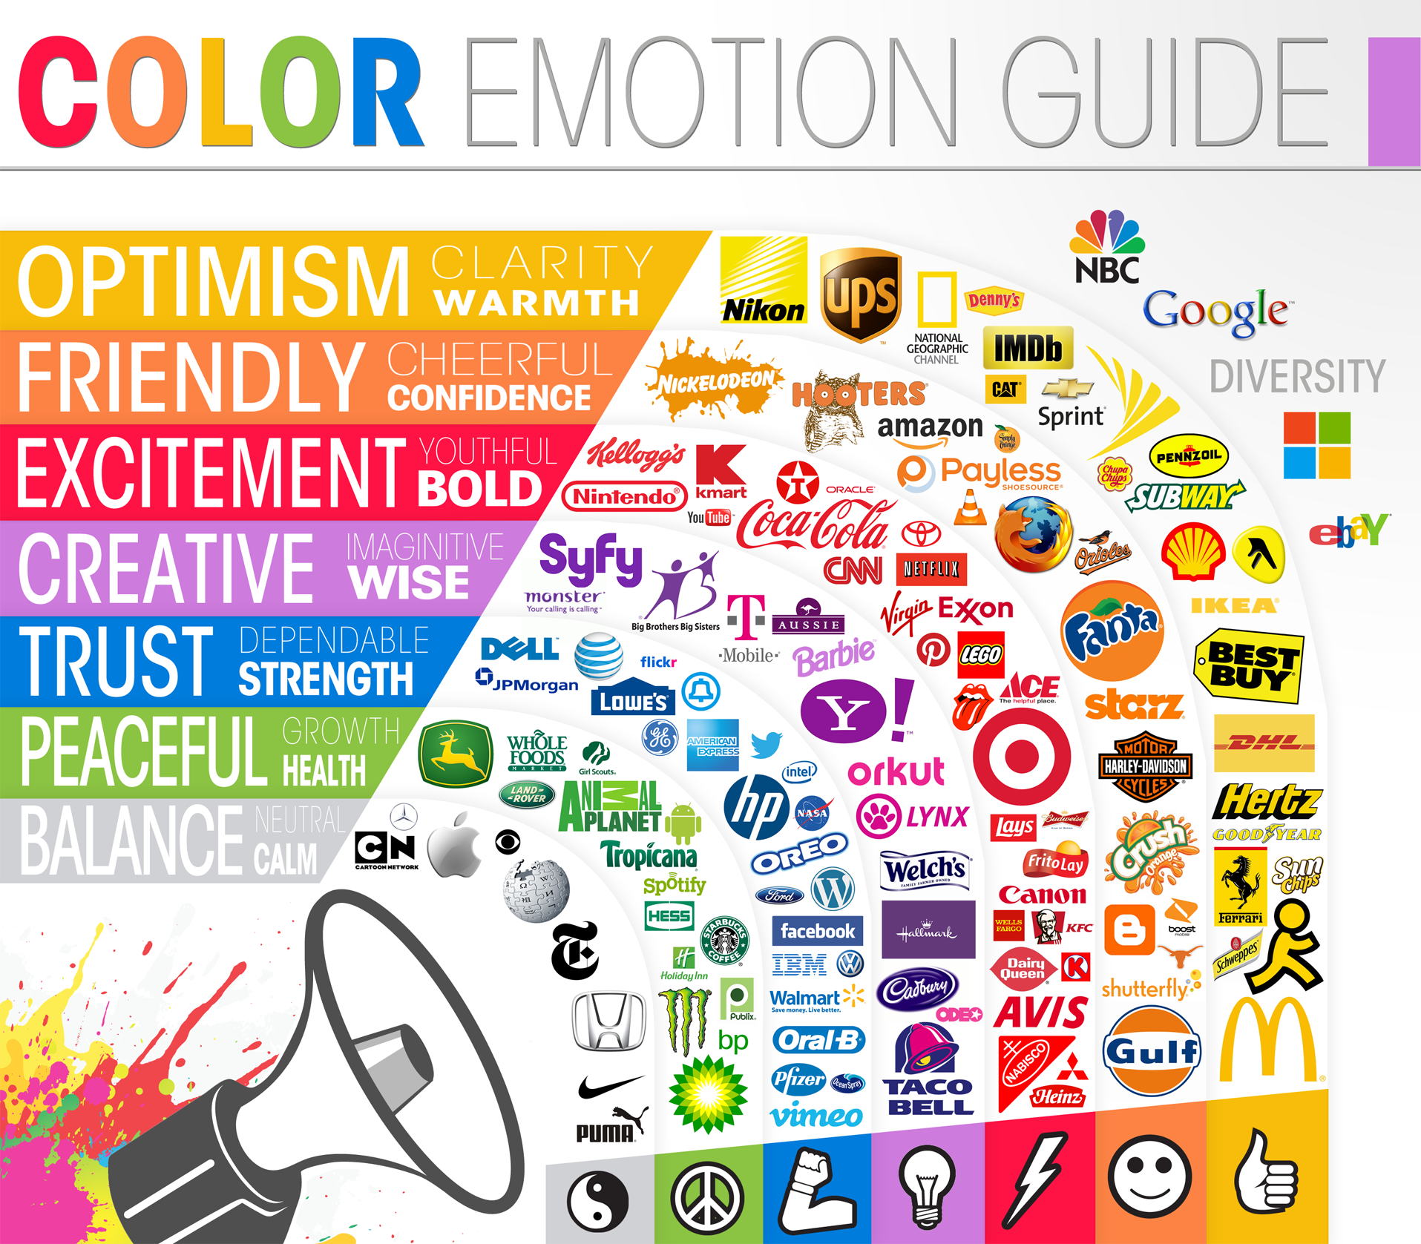

Slide 30
Interesting Marketing Strategies- Guerilla Marketing
Guerrilla Marketing is an advertising strategy that focuses on low-cost unconventional marketing tactics that yield maximum results. This involves high energy and imagination focusing on grasping the attention of the public in more personal and memorable level. The main point of guerrilla marketing is that the activities are done exclusively on the streets or other public places, such as shopping centers, parks or beaches with maximum people access so as to attract a bigger audience.
Many examples of Guerilla Marketing are shown in the next slides as they are very interesting and creative!

Slide 31
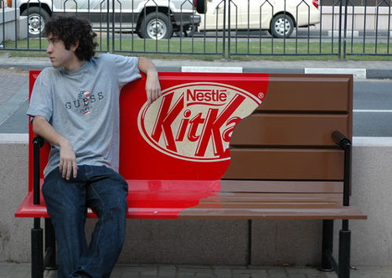

Slide 32
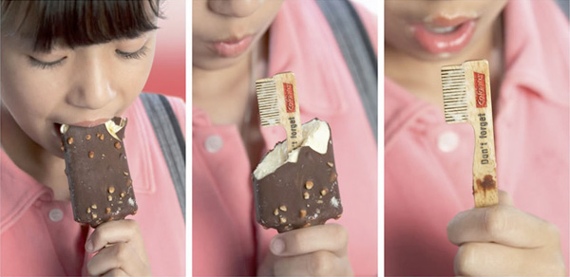

Slide 33
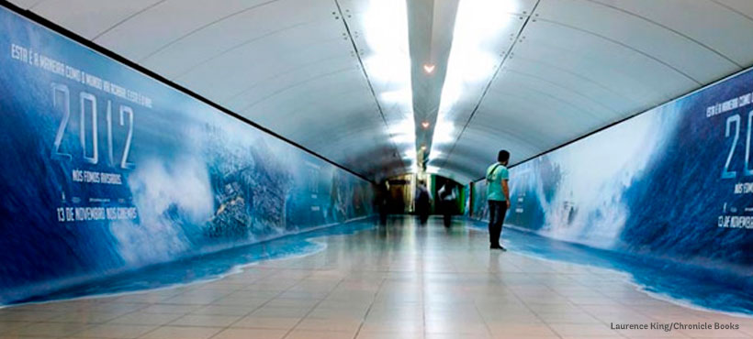

Slide 34
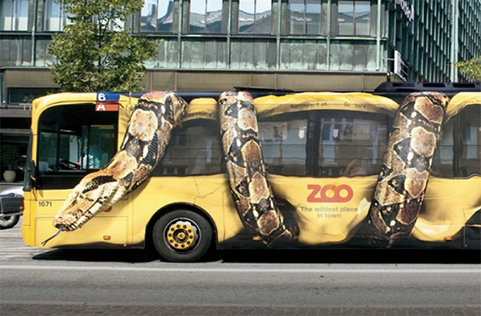

Slide 35
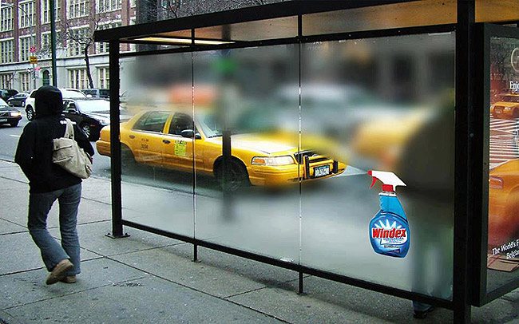

Slide 36
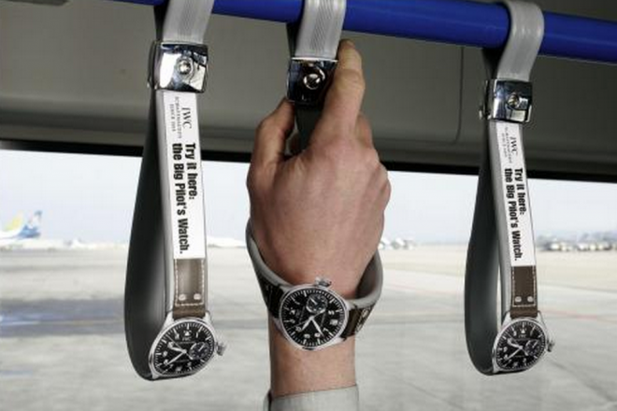

Slide 37
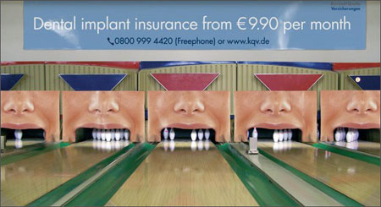

Slide 38
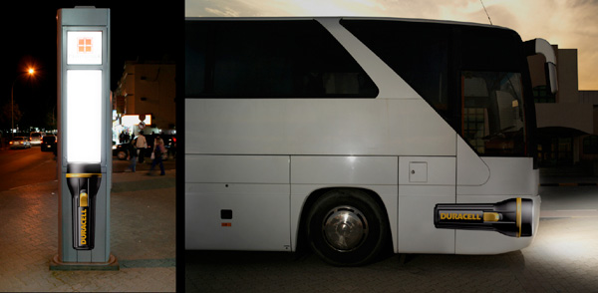

Slide 39
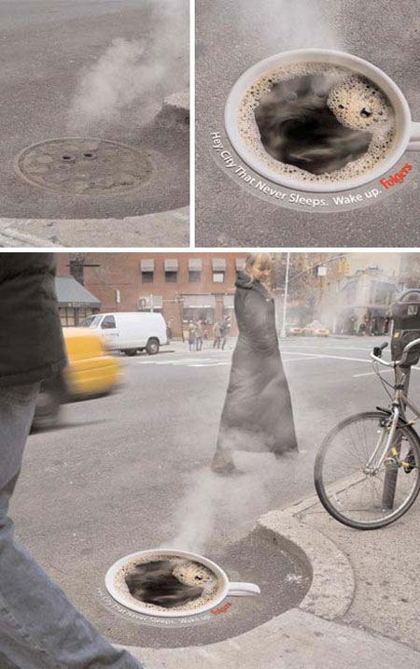

Slide 40
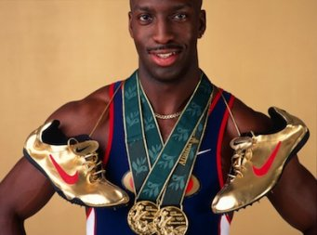
Ambush Marketing
the practice by which a rival company attempts to associate its products with an event that already has official sponsors.
Michael Johnson's famous shoes were one of Nike's many attempts to ambush Reebok's 1996 Olympic sponsorship

Slide 41
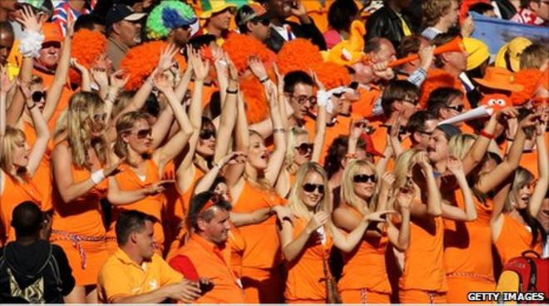
In 2010, during a match between Denmark and Holland, 36 girls were removed from the stadium after being accused of being models for the Dutch beer Bavaria attempting to ambush the World Cup and its official beer sponsor, Budweiser.

Slide 42
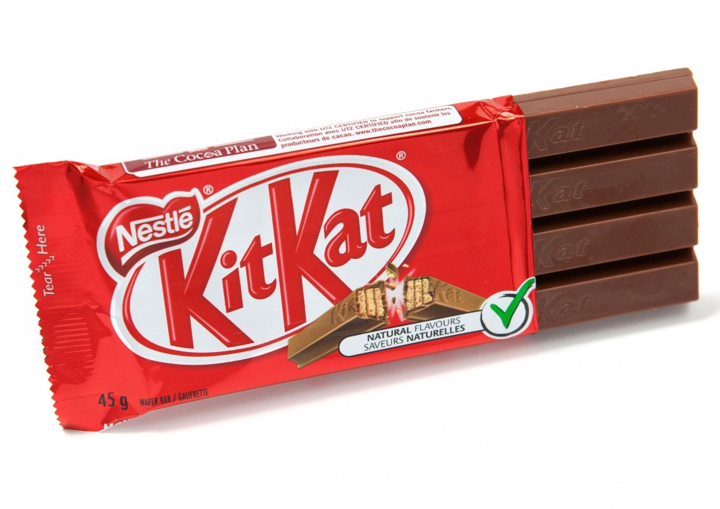

Gray Market and Black Market
Generally, a manufacturer works with a single importer who can sell and support their products in a given region. The importer usually has local dealers and distributors who resell the imported products; this is called a "distribution channel". Gray Market refers to commodities that is imported and sold by methods other than these normal channels.

Slide 43
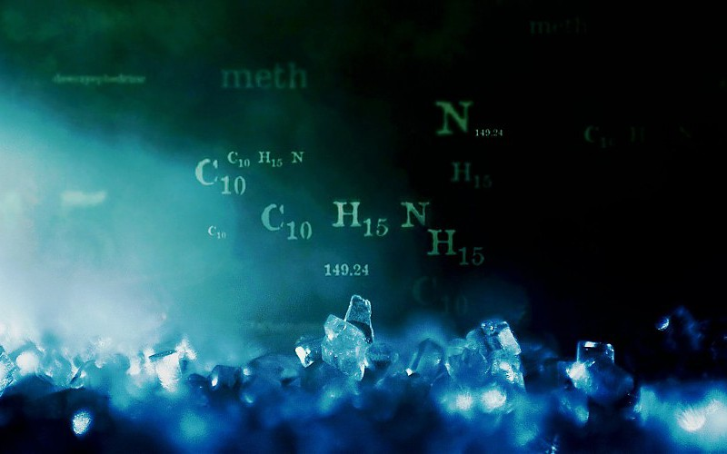
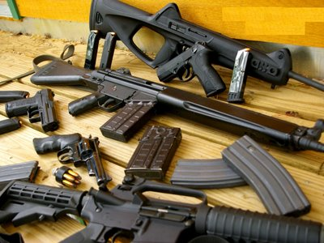
Gray Market and Black Market
Black market deals with the banned, counterfeit or stolen items which are sold in the market illegally.
Black market transactions usually occur “under the table” to let participants avoid government price control or taxes. The black market is also the venue where highly controlled substances or products such as drugs and firearms are illegally traded.

Slide 44


